Slide 1
Confidentiality

Slide 2
Case study ( LM ERICSSON)

Slide 3

Case study of LM Ericsson, 2002:
Outsourcing:
“We have to do it ourselves [internally] because the typical DSPs on the external markets are like an estate wagon with a powerful engine… But if we know the algorithms well enough, we may very well be able to come up with more optimized task-specific designs. We do not want to make those designs available to our customers by sharing the knowledge through the suppliers”

Slide 4
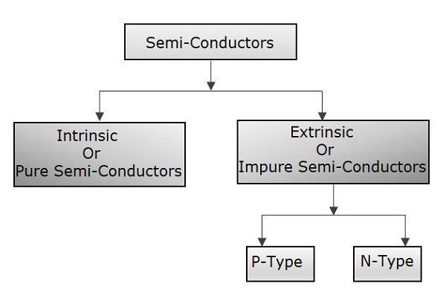

Slide 5
Building own fabrication
“Many suppliers would like to be involved in the design and manufacturing of the most important chips to get a glimpse of our algorithms for Radio Base Station (RBS), but we do not want to risk sharing our own jewels with our competitors through the suppliers”

Slide 6

Overcoming limitations of oursourcing

Slide 8
Demand projection forecast

Slide 9
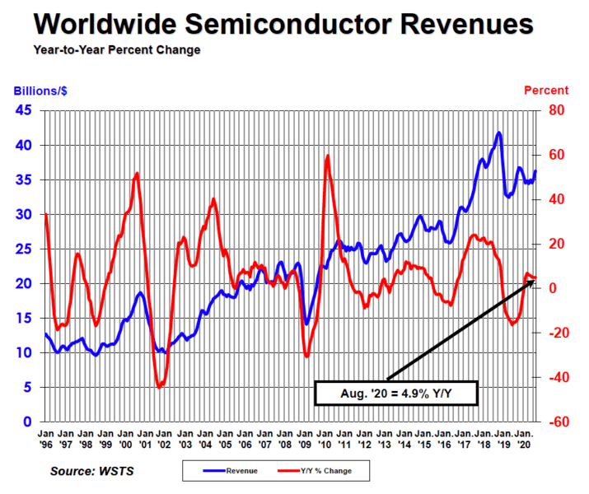
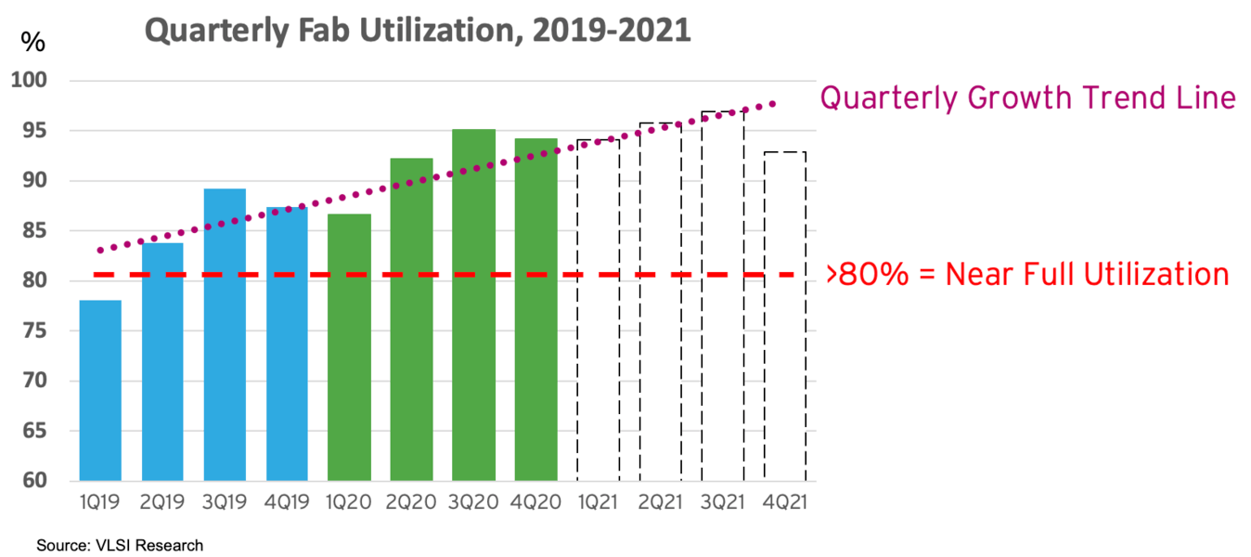
a. Context

Slide 10
Demand forecasting values are overestimated
=>Capacity cannot be utilized efficiently
Demand forecasting values are underestimated
=> Capacity will not be sufficient to fulfil demand, leading to loss of orders of customers

Slide 11
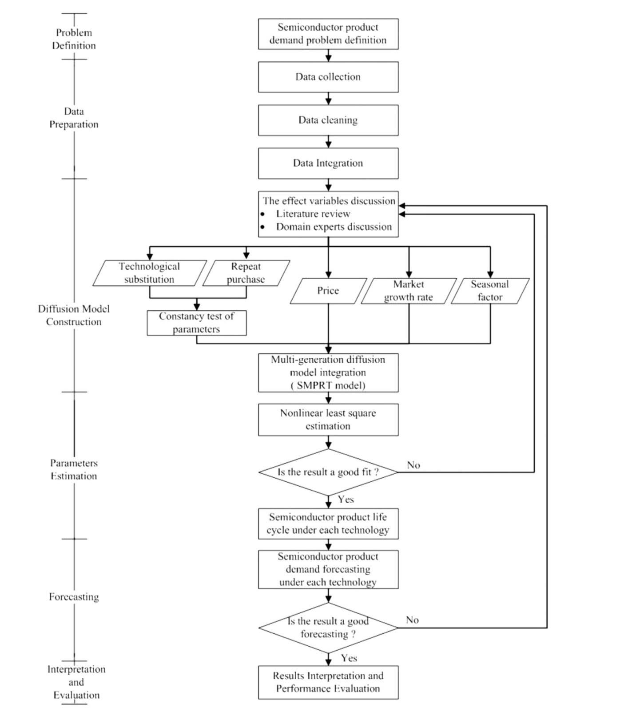
b. The effect Variables in the model to forecast demand
SMPRT demand forecasting model, developed by Norton and Bass in 1987
Technological Substitution Effects
Repeat Purchases
Price Effects
Market Growth Rates
Seasonal Factors
Product demand forecasting framework

Slide 12
1. Technological Substitution effects
Moore's Law refers to Moore's perception that the number of transistors on a microchip doubles every two years, though the cost of computers is halved.

Slide 13
2. Repeat Purchases

Slide 14
3. Price effects
Higher prices => Lower quantity demanded
Lower prices => Higher quantity demanded
Customers expect future price to rise=> Current demand increases but future demand may decrease
Customers expect future price to fall => Current demand decreases but future demand may increase

Slide 15
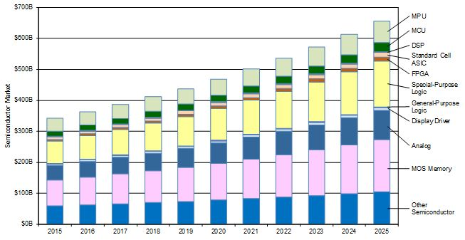
4. Market Growth rates
Source: By Dr. Handel Jones, International Business Strategies (IBS)
When growth rate is rising , the demand might increase

Slide 16
5. Seasonal factor

